Slide 1
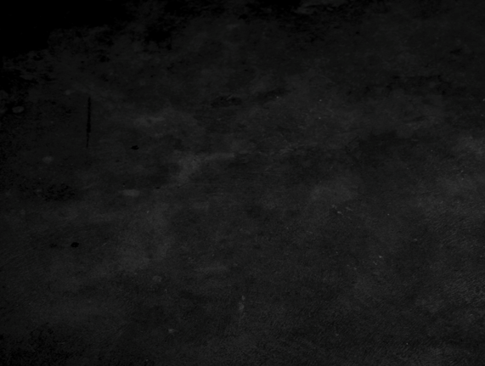




















Convolutional neural networks (CNN)
Angelo Ziletti, PhD
Principal Data Scientist, Bayer AG

Slide 2
Lecture 2 Outline
Part 1.
CNN motivation: beyond MLP
1
Part 2.
Why convolutions
2
Part 3.
CNN: Examples of physics applications
3
Part 4.
Generative Adversarial Networks (GANs)
4

Slide 3
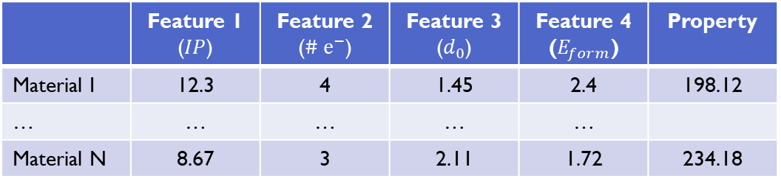
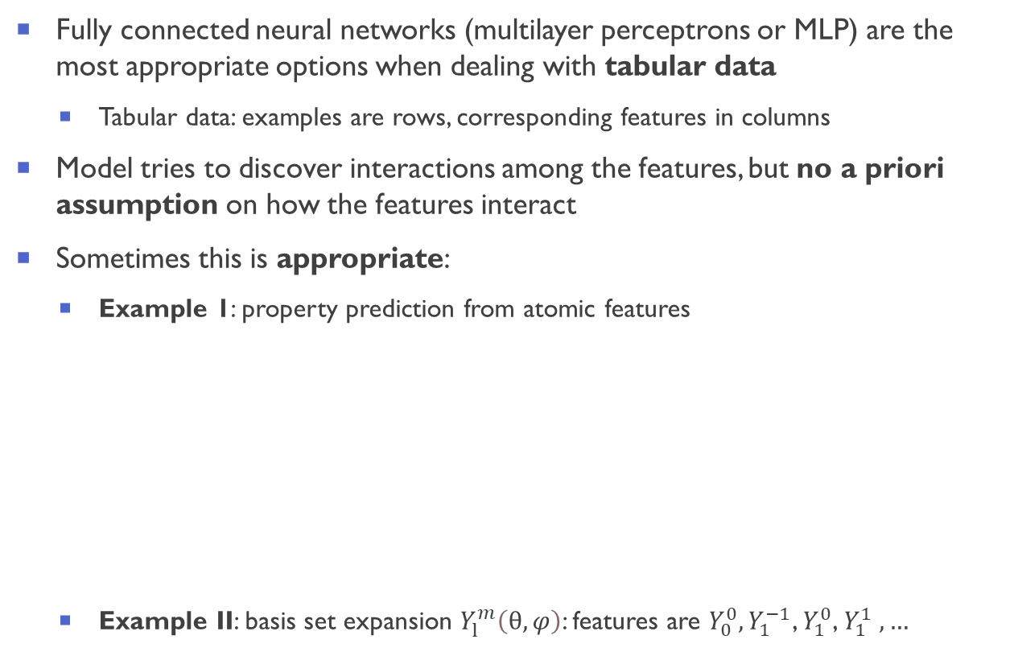
Going beyond multi-layer perceptrons: a-priori knowledge from data structure
Fully connected neural networks (multilayer perceptrons or MLP) are the most appropriate options when dealing with tabular data
Tabular data: examples are rows, corresponding features in columns
Model tries to discover interactions among the features, but no a priori assumption on how the features interact
Sometimes this is appropriate:
Example 1: property prediction from atomic features
Example II: basis set expansion $Y_{l}^{m}\left(θ,φ\right)$: features are $Y_{0}^{0},Y_{1}^{−1}$, $Y_{1}^{0}$, $Y_{1}^{1} ,…$
X
X
X
X
 | Feature 1 ($IP$) | Feature 2 ($\# ⅇ^{−}$) | Feature 3 ($d_{0}$) | Feature 4 ($E_{form}$) | Property
Material I | 12.3 | 4 | 1.45 | 2.4 | 198.12
… | … | … | … | …
Material N | 8.67 | 3 | 2.11 | 1.72 | 234.18
Fully connected neural network
(multilayer perceptron)
X

Slide 4
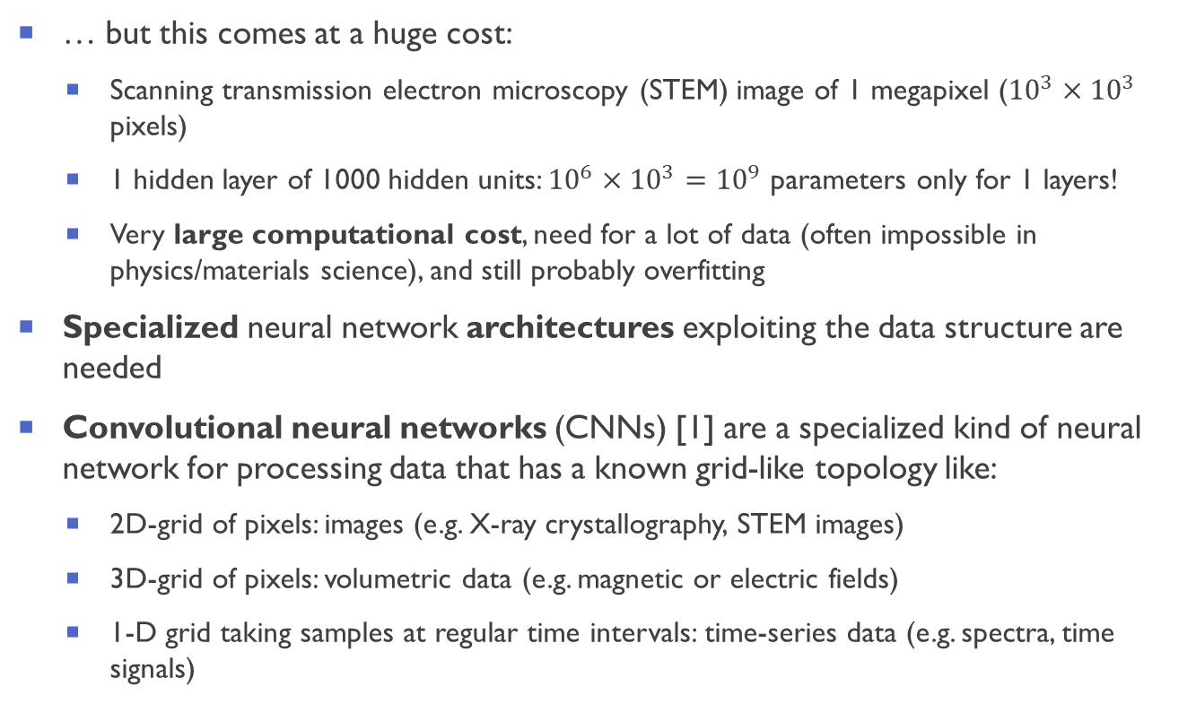
Exploiting structure in data
… but this comes at a huge cost:
Scanning transmission electron microscopy (STEM) image of 1 megapixel (${10}^{3}×{10}^{3}$ pixels)
1 hidden layer of 1000 hidden units: ${10}^{6}×{10}^{3}={10}^{9}$ parameters only for 1 layers!
Very large computational cost, need for a lot of data (often impossible in physics/materials science), and still probably overfitting
Specialized neural network architectures exploiting the data structure are needed
Convolutional neural networks (CNNs) [1] are a specialized kind of neural network for processing data that has a known grid-like topology like:
2D-grid of pixels: images (e.g. X-ray crystallography, STEM images)
3D-grid of pixels: volumetric data (e.g. magnetic or electric fields)
1-D grid taking samples at regular time intervals: time-series data (e.g. spectra, time signals)
X
X
X
X
Fully connected neural network
(multilayer perceptron)
X
[1] LeCun et al., Neural Comput. 1, 541 (1989)

Slide 5
Convolutional neural networks (CNN)
Two guiding principles for CNNs:
Equivariant representations: network should respond similarly to the same patch regardless on where it appears in the data
Locality principle: since the data has a grid-like topology, the network can focus on local regions (in earlier layers)
These local representations will then be aggregates to make predictions at the whole data level
Example of images:
Equivariant representations: if we move the object by 20 pixels in the image, the output signal will just moved by the same amount; this also implies that all patches of an image will be treated in the same manner
Locality principle: only a small neighborhood of pixels will be used to compute the corresponding hidden representations
These simple principles are clever because they allow at the same time:
exploit the grid-like structure of the input data
dramatically reduce the number of required neural network parameters (very smart regularization)
This is a general principle: build-in knowledge of your data in the neural network architecture

Slide 6












Slide 7
















Slide 8













Slide 9


















Slide 10










Slide 11











Slide 12












Slide 13




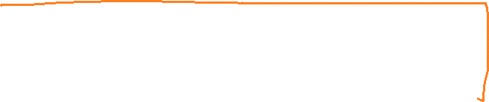


Slide 14

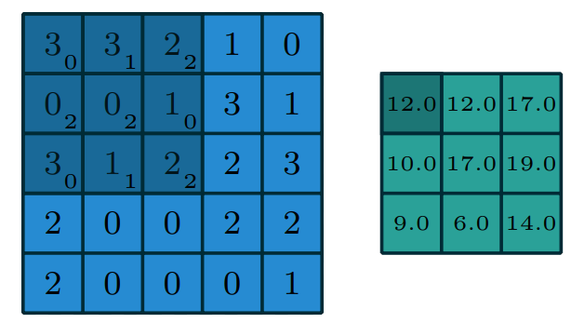
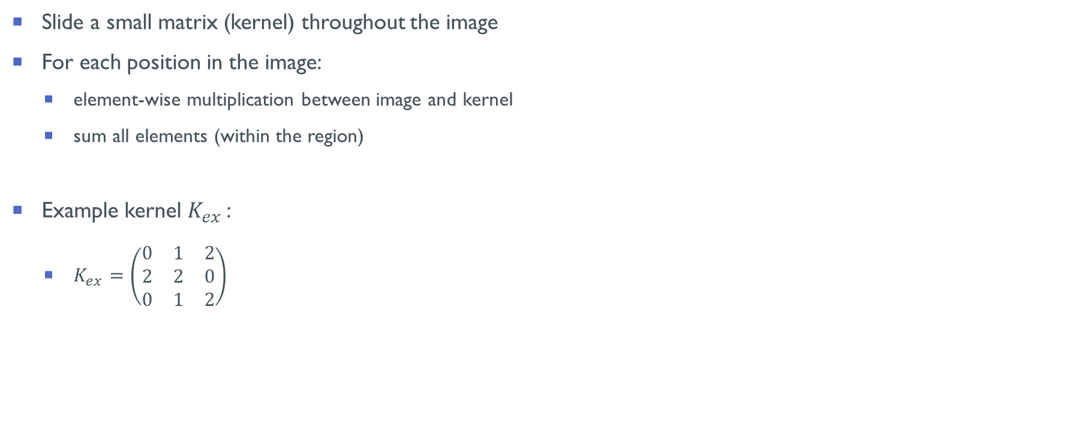
Computing a (discrete) convolution
Slide a small matrix (kernel) throughout the image
For each position in the image:
element-wise multiplication between image and kernel
sum all elements (within the region)
Example kernel $K_{ex}$:
$K_{ex}=\left(\begin{matrix}0 & 1 & 2 \\ 2 & 2 & 0 \\ 0 & 1 & 2\end{matrix}\right)$
Output
Kernel
Input
Figures from V. Dumoulin and F. Visin, ArXiv:1603.07285 (2016)

Slide 15
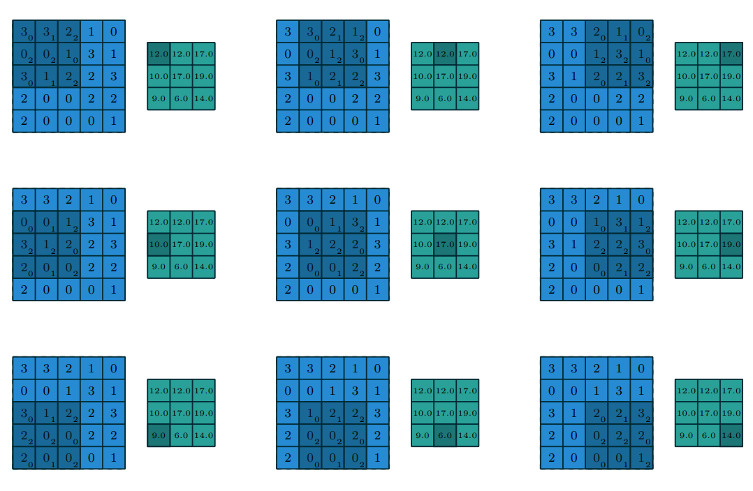
Computing a (discrete) convolution: example
Figures from V. Dumoulin and F. Visin, ArXiv:1603.07285 (2016)

Slide 16
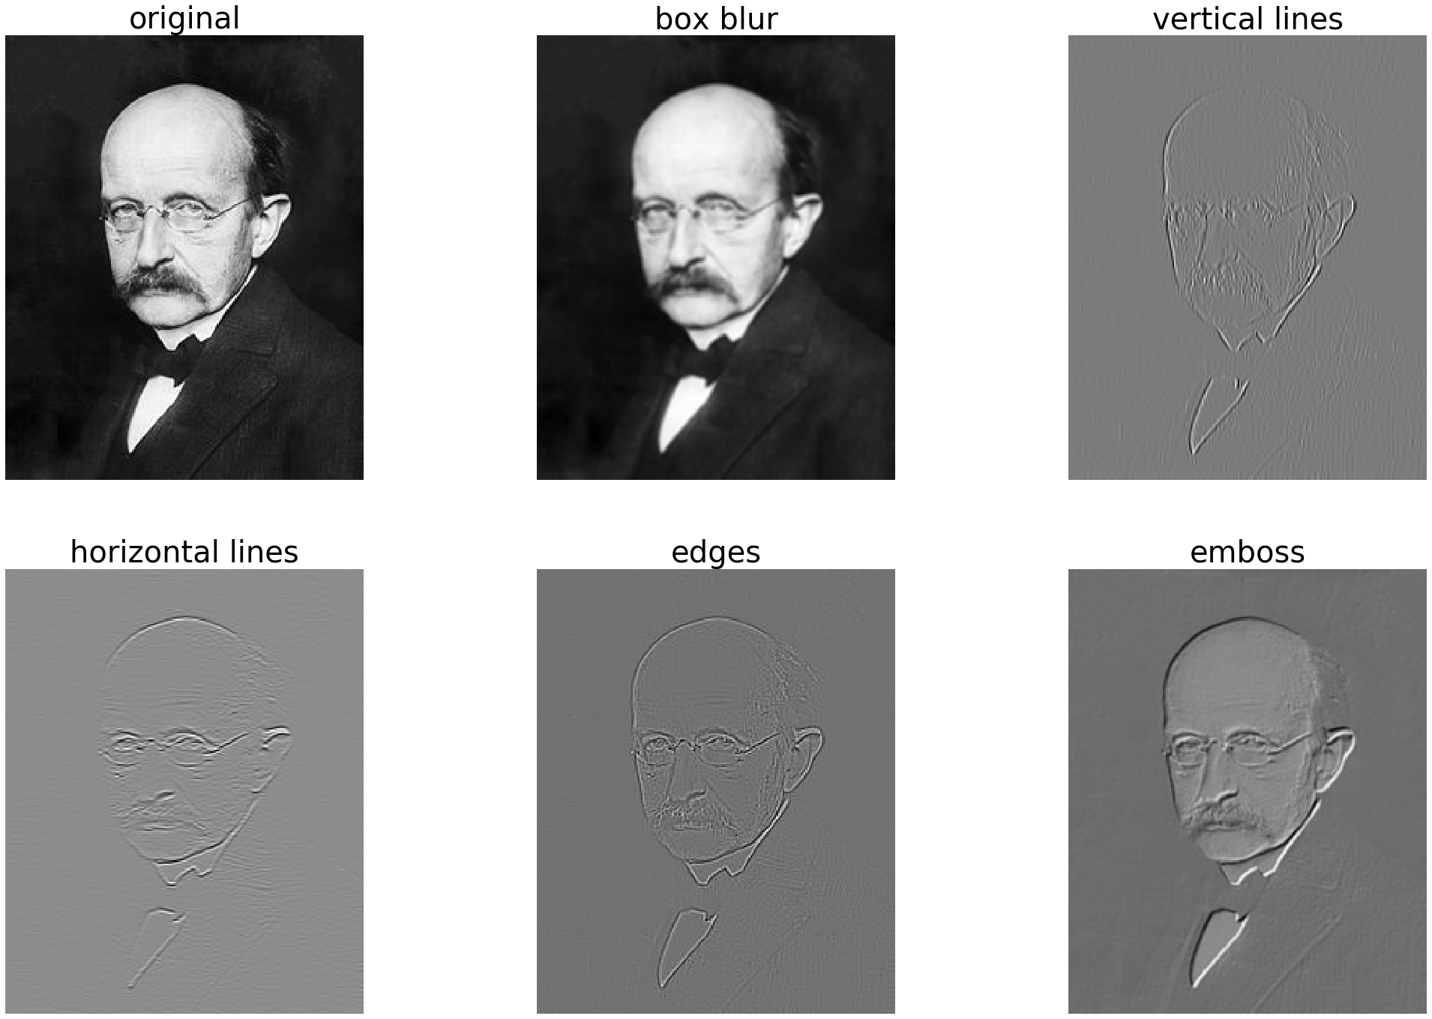
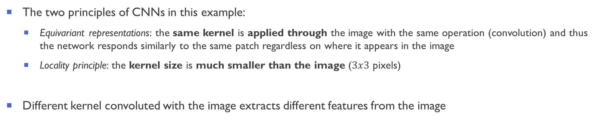
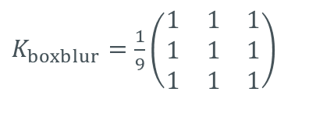
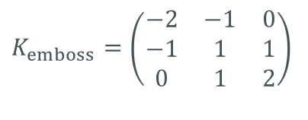
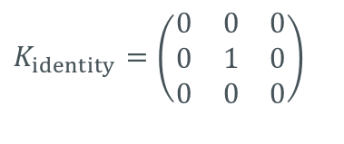
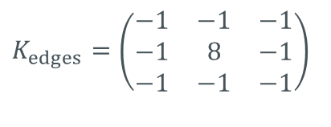
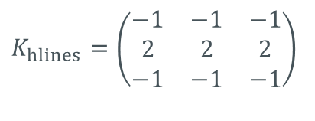
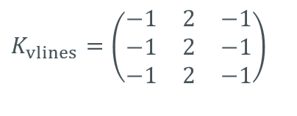
Convolution and kernels: example 1
$K_{identity}=\left(\begin{matrix}0 & 0 & 0 \\ 0 & 1 & 0 \\ 0 & 0 & 0\end{matrix}\right)$
$K_{boxblur}=\frac{1}{9}\left(\begin{matrix}1 & 1 & 1 \\ 1 & 1 & 1 \\ 1 & 1 & 1\end{matrix}\right)$
$K_{vlines}=\left(\begin{matrix}−1 & 2 & −1 \\ −1 & 2 & −1 \\ −1 & 2 & −1\end{matrix}\right)$
$K_{hlines}=\left(\begin{matrix}−1 & −1 & −1 \\ 2 & 2 & 2 \\ −1 & −1 & −1\end{matrix}\right)$
$K_{edges}=\left(\begin{matrix}−1 & −1 & −1 \\ −1 & 8 & −1 \\ −1 & −1 & −1\end{matrix}\right)$
$K_{emboss}=\left(\begin{matrix}−2 & −1 & 0 \\ −1 & 1 & 1 \\ 0 & 1 & 2\end{matrix}\right)$
The two principles of CNNs in this example:
Equivariant representations: the same kernel is applied through the image with the same operation (convolution) and thus the network responds similarly to the same patch regardless on where it appears in the image
Locality principle: the kernel size is much smaller than the image ($3x3$ pixels)
Different kernel convoluted with the image extracts different features from the image

Slide 17
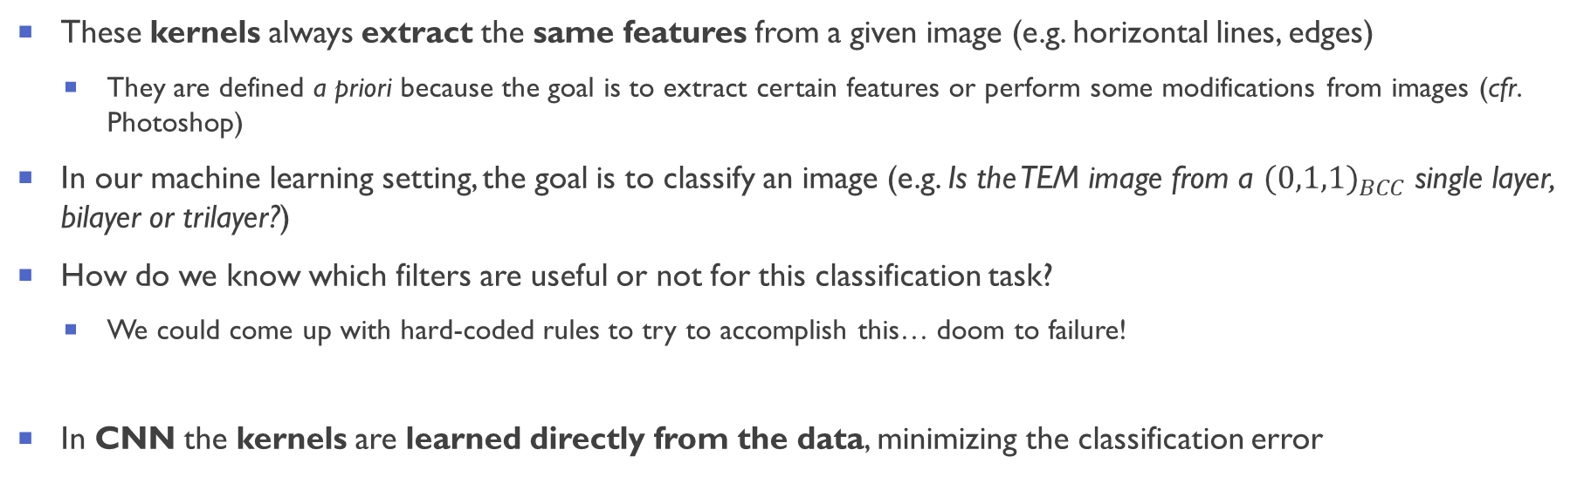
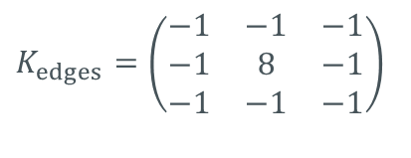
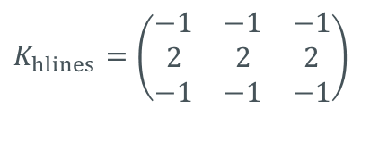
CNN: learning filters
$K_{hlines}=\left(\begin{matrix}−1 & −1 & −1 \\ 2 & 2 & 2 \\ −1 & −1 & −1\end{matrix}\right)$
$K_{edges}=\left(\begin{matrix}−1 & −1 & −1 \\ −1 & 8 & −1 \\ −1 & −1 & −1\end{matrix}\right)$
These kernels always extract the same features from a given image (e.g. horizontal lines, edges)
They are defined a priori because the goal is to extract certain features or perform some modifications from images (cfr. Photoshop)
In our machine learning setting, the goal is to classify an image (e.g. Is the TEM image from a ${(0,1,1)}_{BCC}$ single layer, bilayer or trilayer?)
How do we know which filters are useful or not for this classification task?
We could come up with hard-coded rules to try to accomplish this… doom to failure!
In CNN the kernels are learned directly from the data, minimizing the classification error

Slide 18


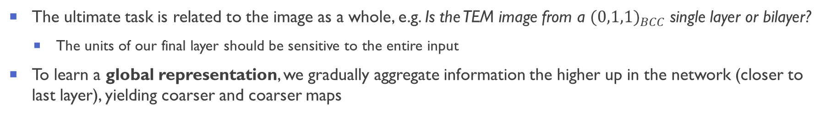
Aggregating representations: pooling or larger stride convolutions
The ultimate task is related to the image as a whole, e.g. Is the TEM image from a ${(0,1,1)}_{BCC}$ single layer or bilayer?
The units of our final layer should be sensitive to the entire input
To learn a global representation, we gradually aggregate information the higher up in the network (closer to last layer), yielding coarser and coarser maps
Pooling:
replaces the output at a certain location with a summary statistic of the nearby outputs
Convolution with larger strides [1]:
allows to be sensitive to a larger portion of the image with one kernel
[1] Springeberger et al., ICLR workshop track, ArXiv: 1412.6806 (2015)
Figure from V. Dumoulin and F. Visin, ArXiv:1603.07285 (2016)
Figure from https://cs231n.github.io/convolutional-networks/

Slide 19

The first CNN: LeNet (1989)
Task: classify handwritten digits from 1 to 9 (MNIST dataset)
LeCun proposes the first convolutional neural network [1]
Arguably the first breakthrough in machine learning
Figure from Wikipedia
Figure from d2l.ai
[1] LeCun et al., (1998), Proceedings of the IEEE, 86(11), 2278–2324 (1998)

Slide 20
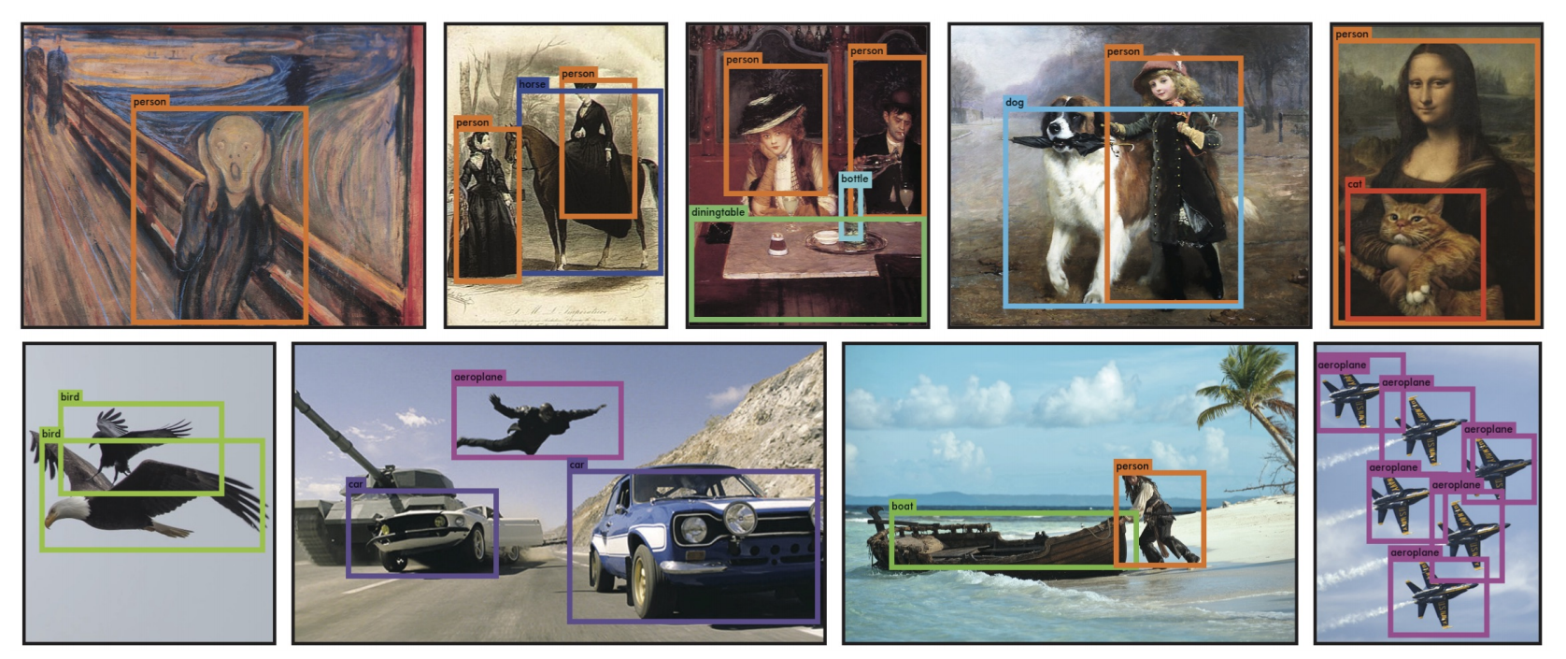
Object detection based on CNN (You only look once, YOLO [1])
[1] Redmon et al., IEEE Conference on Computer Vision and Pattern Recognition (CVPR) (2016)

Slide 21
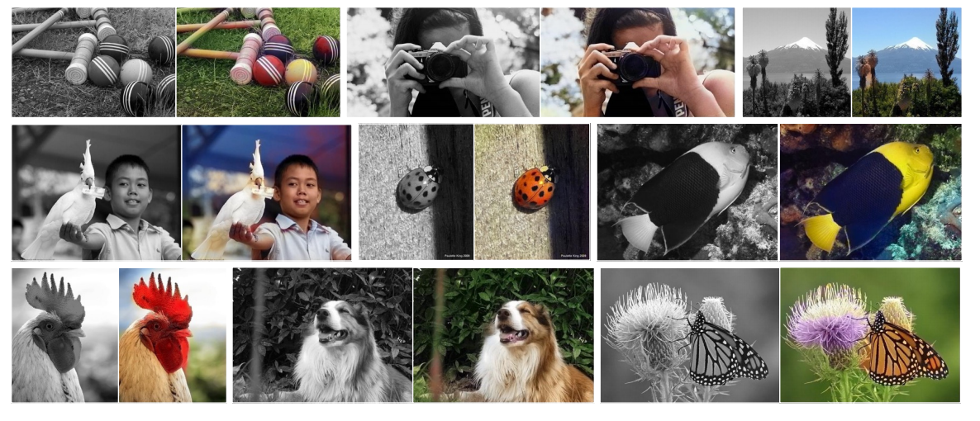
Image colorization with CNNs
[1] Zhang et al., ECCV (2016), ArXiv: 1603.08511 (2016)

Slide 22
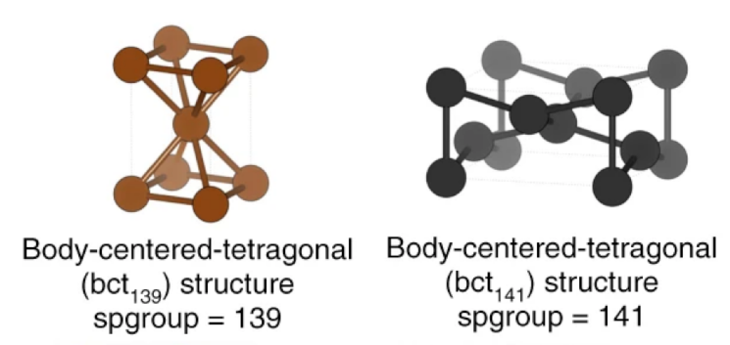
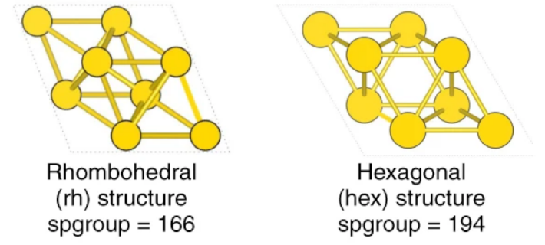
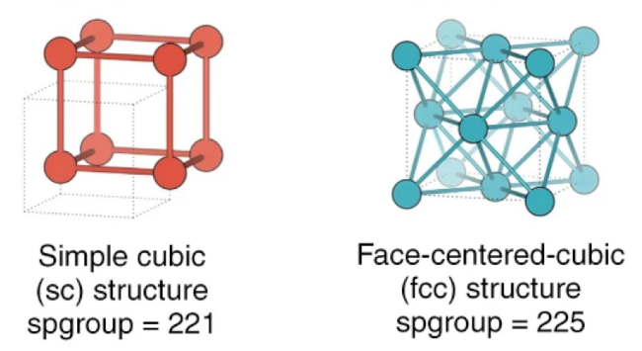
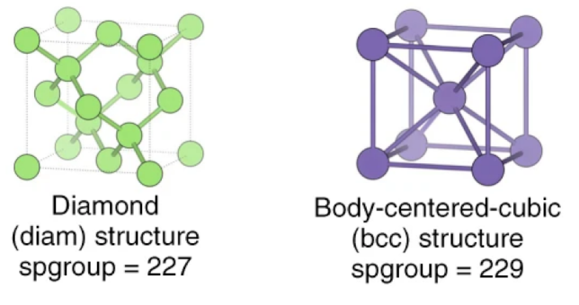
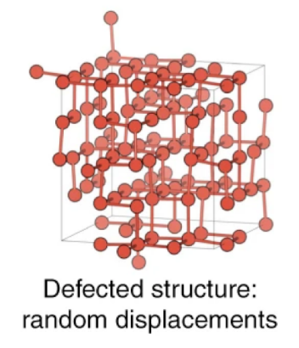
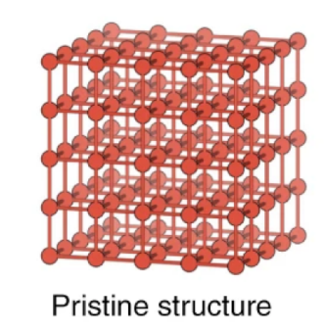
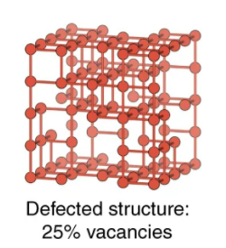
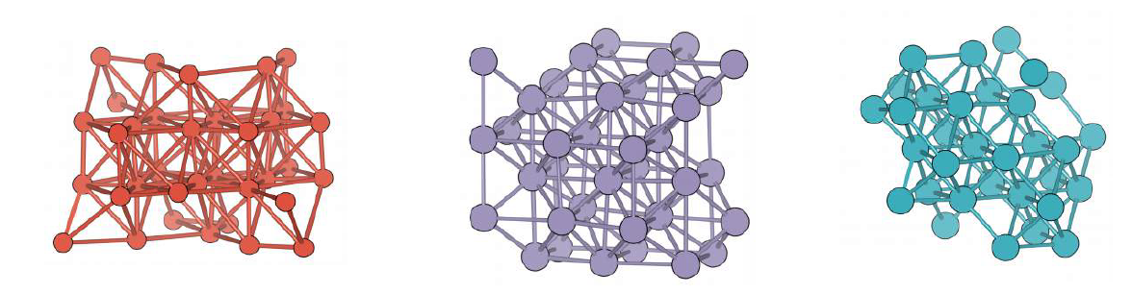
CNN for (insightful) crystal structure recognition
The goal: given an atomic arrangement in a nanomaterial, determine the (“most similar”) prototype among the following classes:
Assignment should be robust with respect to atom removals and deformations:
A. Ziletti et al., Nature Communications, 9, 2775 (2018).

Slide 23
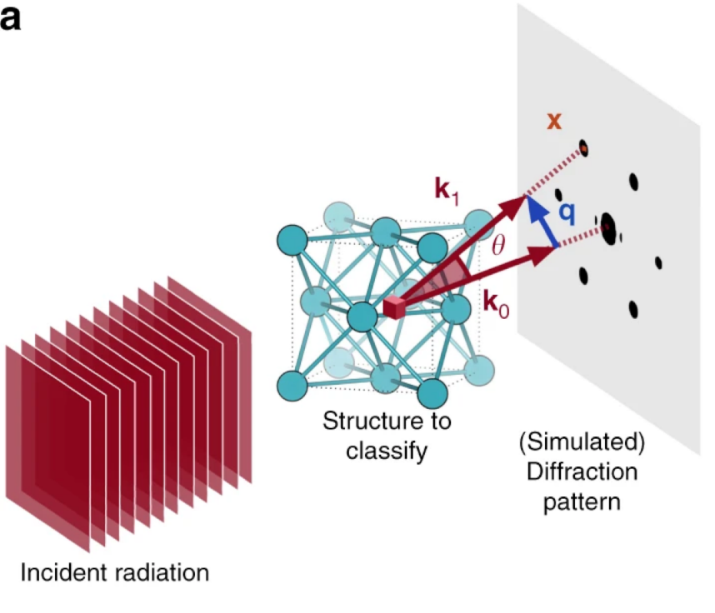
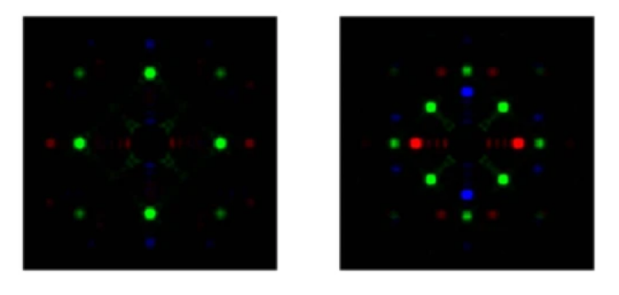
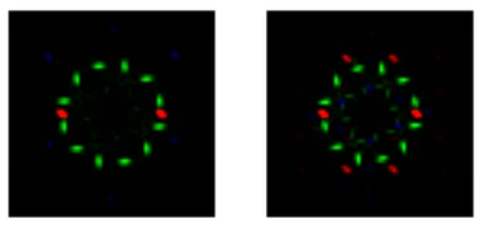
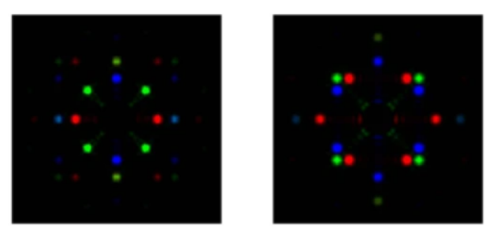
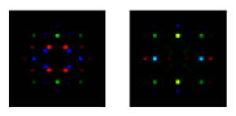
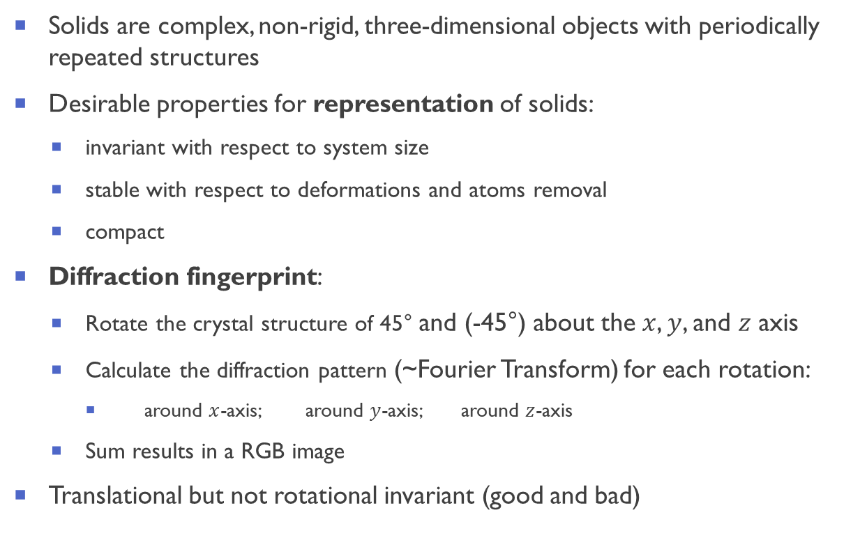
Representing the crystals with an image: diffraction fingerprint
Solids are complex, non-rigid, three-dimensional objects with periodically repeated structures
Desirable properties for representation of solids:
invariant with respect to system size
stable with respect to deformations and atoms removal
compact
Diffraction fingerprint:
Rotate the crystal structure of 45° and (-45°) about the $x$, $y$, and $z$ axis
Calculate the diffraction pattern (~Fourier Transform) for each rotation:
around $x$-axis; around $y$-axis; around $z$-axis
Sum results in a RGB image
Translational but not rotational invariant (good and bad)
A. Ziletti et al., Nature Communications, 9, 2775 (2018).

Slide 24
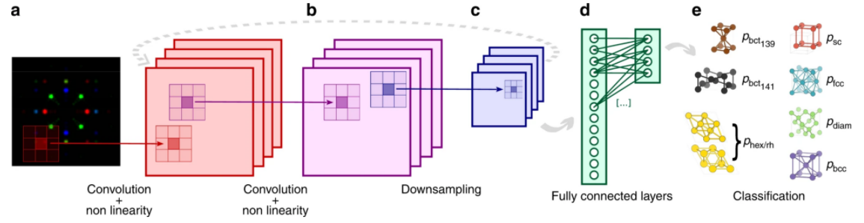
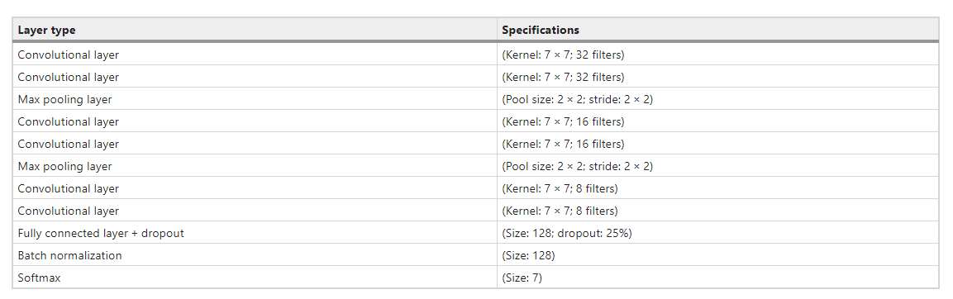
CNN for crystal structure classification: architecture
A. Ziletti et al., Nature Communications, 9, 2775 (2018).

Slide 25

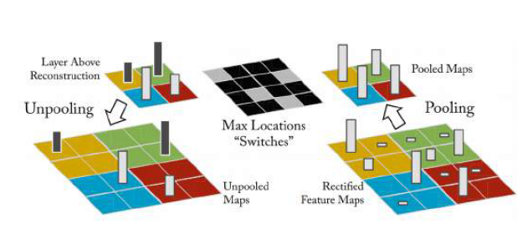
Opening the black box of CNNs
Going backwards: reconstruction
Forward pass
Input to layer
Reconstruction
Convolution
Fractionally strided convolution
Also called:
Transposed convolution
Backward strided convolution
Deconvolution
Nonlinearity
Nonlinearity
Pooling
Unpooling
Store pool switches at forward pass
Unpool the top filters in backward pass
Next layer
Layer above reconstruction
[Method] Zeiler and Fergus, European Conf. on Computer Vision, Springer (2014)
[Application to Materials Science] A. Ziletti et al., Nature Communications, 9, 2775 (2018).
Hands-on example in the tutorial…

Slide 26
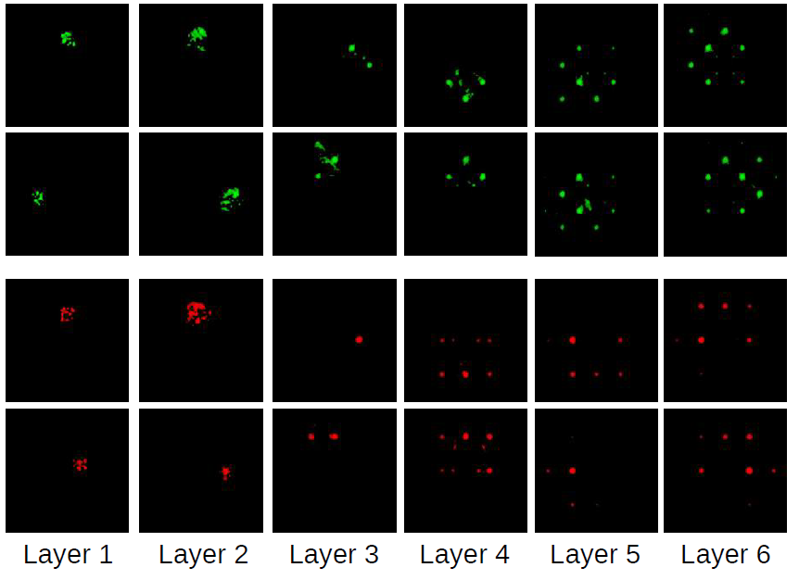
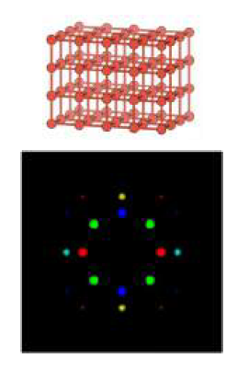
Understanding CNN with attentive response maps
Attentive response maps
Attentive response maps: the brighter the pixel, the more important is that location for classification
Comparing across layers, the CNN filters are composed in a hierarchical fashion, increasing their complexity from one layer to another
It demonstrates that deep learning learns its own features
Input image
A. Ziletti et al., Nature Communications, 9, 2775 (2018).

Slide 27
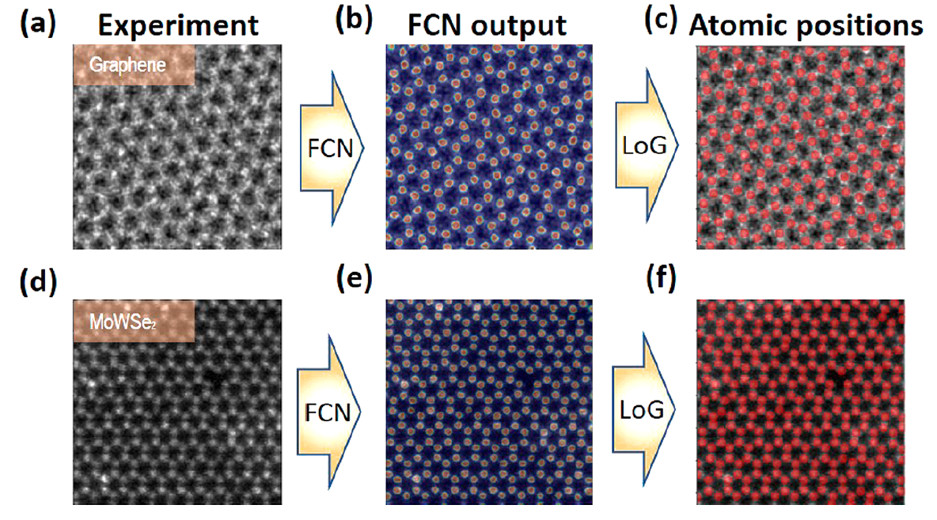
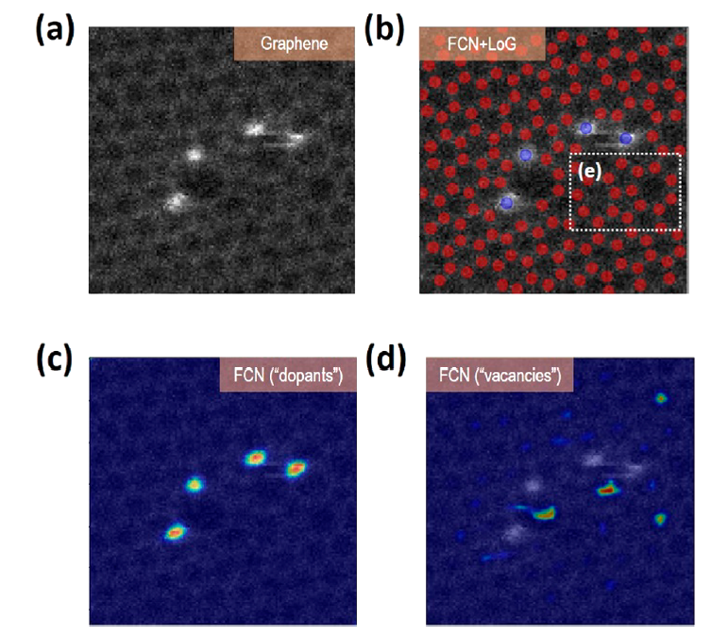
CNN for detecting atomic positions from experimental STEM images
[1] uses of deep neural networks (CNN) to extract atomic species and type of defects from atomically resolved scanning transmission electron microscopy (STEM) images
Finding atomic positions from raw experimental images graphene (a-c) and Mo1−xWxSe2 (d-f), using FCN and Laplacian of Gaussian (LoG) blob detection method
Prediction of defect types from STEM images: FCN output for class “dopants” (c) and class “vacancy” (d)
[1] M. Ziatdinov et al., ACS nano 11, 12742–12752 (2017)

Slide 28
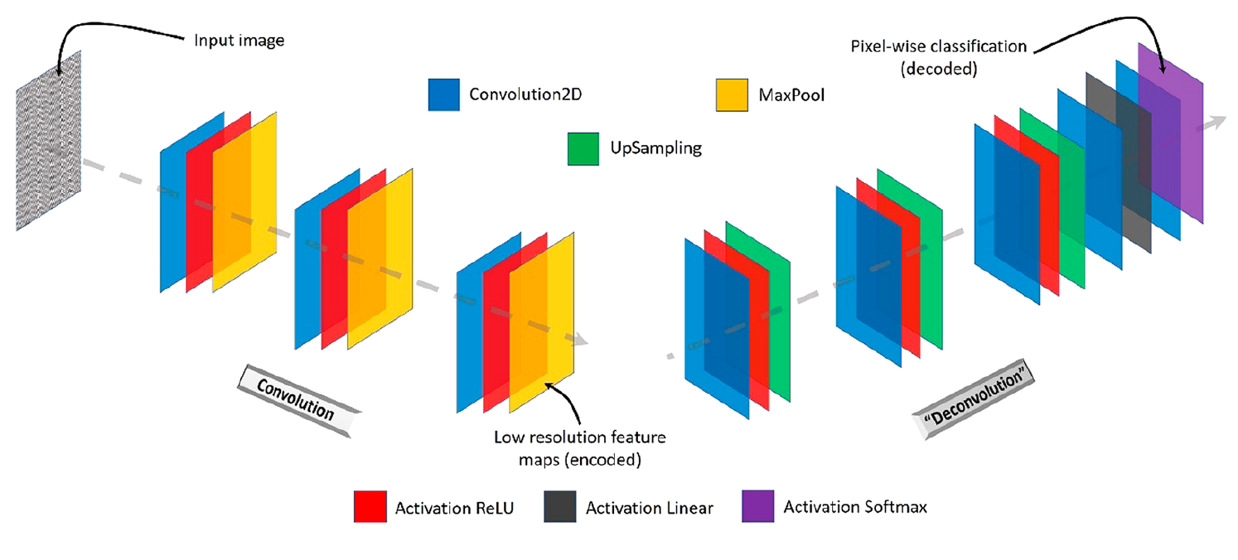
CNN for detecting atomic positions from experimental STEM images
Uses as special type of CNN called fully-convolutional neural network (FCN)
No dense layers, less parameters, can predict pixel-wise
Harder to build a “global” representation
Trained using the simulated, theoretical images (e.g. ab initio molecular dynamics) of atomic lattice and defects
Applied the trained model to the experimental data (i.e. test set)
In physics/materials science you can generate your own training data from first principles: a big advantage
U-shape fully convolutional network (FCN)
[1] M. Ziatdinov et al., ACS nano 11, 12742–12752 (2017) [FCN] Long et al, CVPR, ArXiv:1411.4038 (2015)

Slide 29
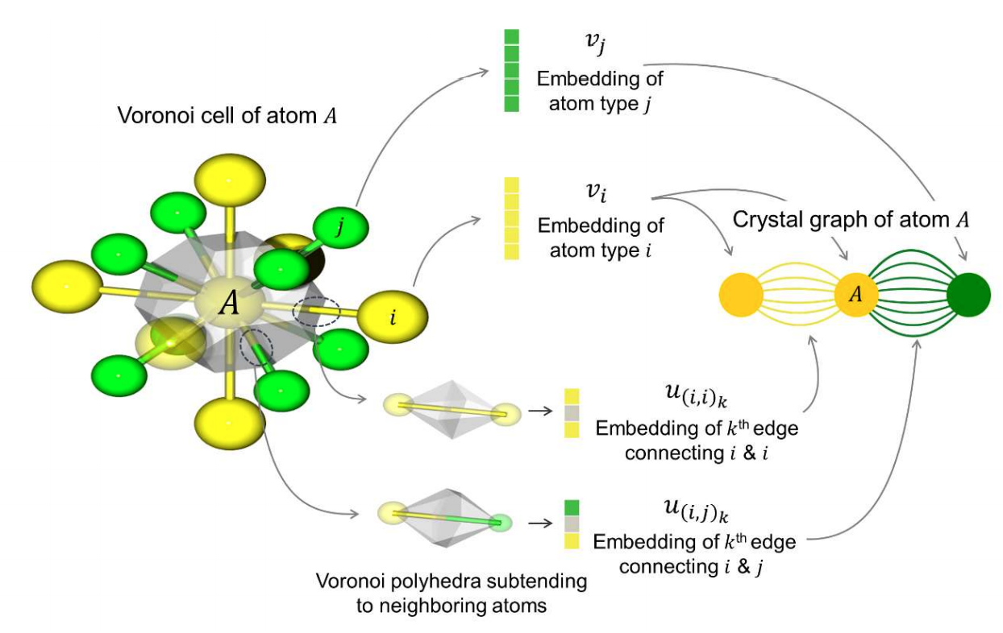
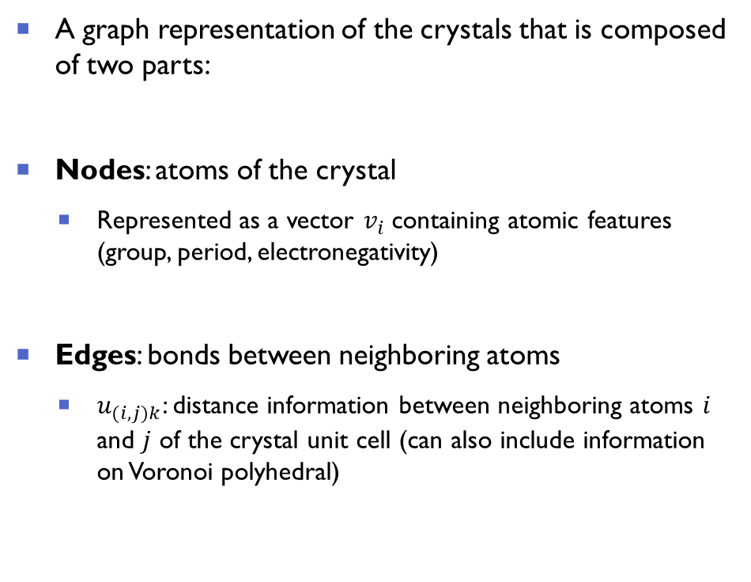
Crystal graph CNN (1/2)
A graph representation of the crystals that is composed of two parts:
Nodes: atoms of the crystal
Represented as a vector $v_{i}$containing atomic features (group, period, electronegativity)
Edges: bonds between neighboring atoms
$u_{(i,j)k}$: distance information between neighboring atoms 𝑖 and 𝑗 of the crystal unit cell (can also include information on Voronoi polyhedral)
Figure taken from [3]
[1] T. Xie and J. C. Grossman, Phys. Rev. Lett. 120,145301 (2018) [2] Cheol Woo Park, Chris Wolverton, Phys. Rev. Materials 4, 063801 (2020)

Slide 30
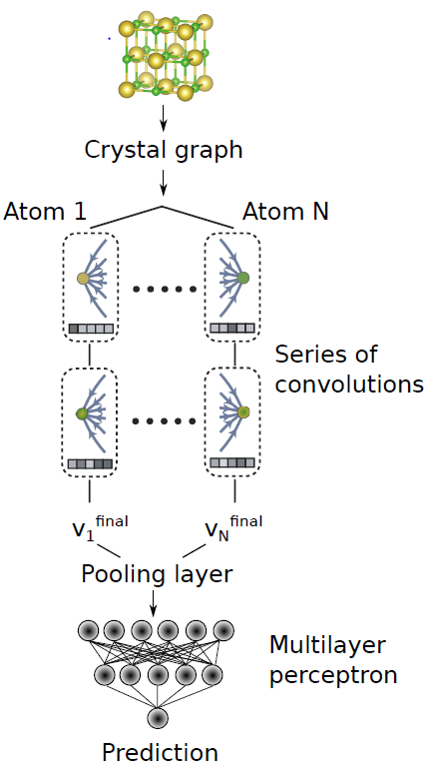
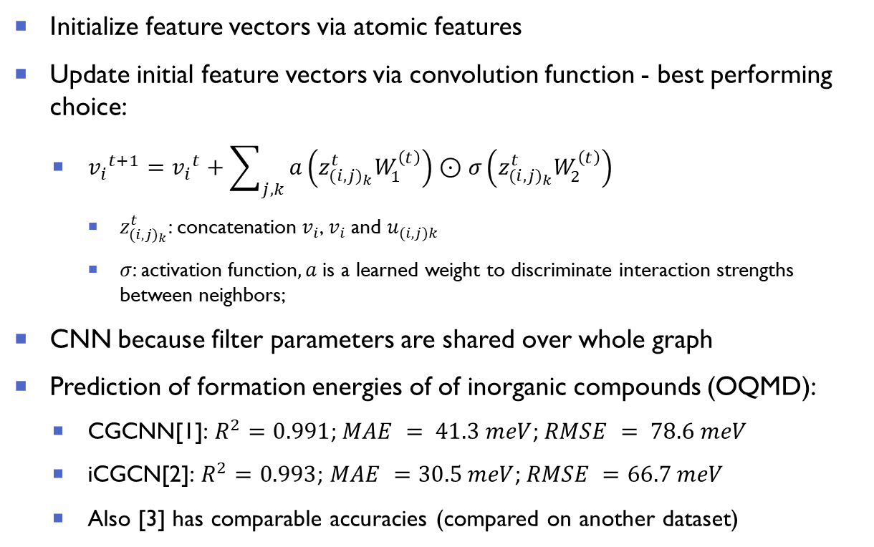
Crystal graph CNN (2/2)
Initialize feature vectors via atomic features
Update initial feature vectors via convolution function - best performing choice:
${v_{i}}^{t+1}={v_{i}}^{t}+\sum_{j,k}{a\left(z_{(i,{j)}_{k}}^{t}W_{1}^{\left(t\right)}\right)}⊙σ\left(z_{(i,{j)}_{k}}^{t}W_{2}^{\left(t\right)}\right)$
$z_{(i,{j)}_{k}}^{t}$: concatenation $v_{i}$, $v_{i}$and $u_{(i,j)k}$
$σ$: activation function$, a$ is a learned weight to discriminate interaction strengths between neighbors;
CNN because filter parameters are shared over whole graph
Prediction of formation energies of of inorganic compounds (OQMD):
CGCNN[1]: $R^{2}=0.991$; $MAE = 41.3 meV$; $RMSE = 78.6 meV$
iCGCN[2]: $R^{2}=0.993$; $MAE =30.5 meV$; $RMSE =66.7 meV$
Also [3] has comparable accuracies (compared on another dataset)
Figure courtesy of Andreas Leitherer
[1] T. Xie and J. C. Grossman, Phys. Rev. Lett. 120,145301 (2018) [2] C. Park, C. Wolverton, Phys. Rev. Materials 4, 063801 (2020)
[3] Schütt et al., J. Chem. Phys 148, 241722 (2018)

Slide 31
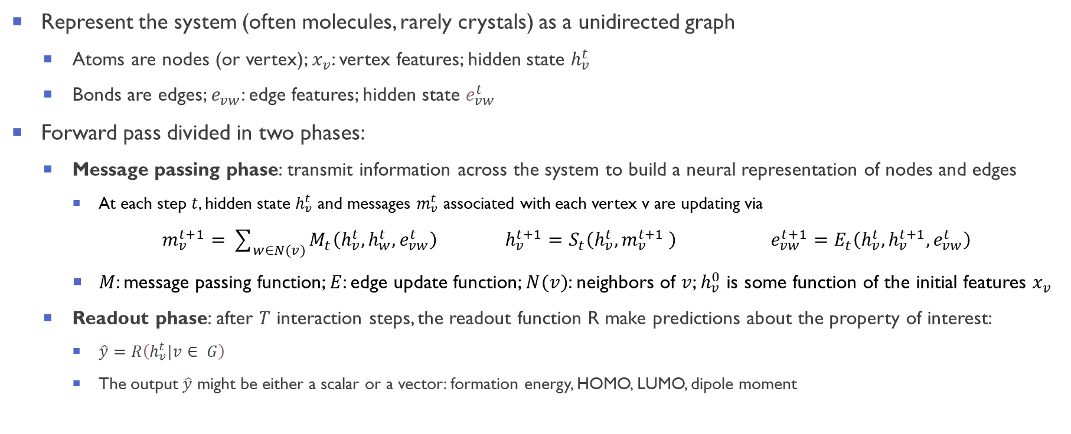
Message passaging neural networks
Represent the system (often molecules, rarely crystals) as a unidirected graph
Atoms are nodes (or vertex); $x_{v}$: vertex features; hidden state $h_{v}^{t}$
Bonds are edges; $e_{vw}$: edge features; hidden state $e_{vw}^{t}$
Forward pass divided in two phases:
Message passing phase: transmit information across the system to build a neural representation of nodes and edges
At each step $t$, hidden state $h_{v}^{t}$ and messages $m_{v}^{t}$ associated with each vertex v are updating via
$m_{v}^{t+1}=\sum_{w∈N(v)}{M_{t}\left(h_{v}^{t},h_{w}^{t},e_{vw}^{t}\right)}$ $h_{v}^{t+1}=$ $S_{t}\left(h_{v}^{t},m_{v}^{t+1} \right)$ $e_{vw}^{t+1}=$ $E_{t}\left(h_{v}^{t},h_{v}^{t+1},e_{vw}^{t}\right)$
$M$: message passing function; $E$: edge update function; $N(v)$: neighbors of $v$; $h_{v}^{0}$ is some function of the initial features $x_{v}$
Readout phase: after $T$ interaction steps, the readout function R make predictions about the property of interest:
$\hat{y}=R\left(h_{v}^{t}|v∈ G\right)$
The output $\hat{y}$ might be either a scalar or a vector: formation energy, HOMO, LUMO, dipole moment
[1] J. Gilmer et al., ICML 70, 1263 (2017) [2] Schütt et al., J. Chem. Phys 148, 241722 (2018) [3] Jørgensen et al., NIPS 2018, 1806.03146 (2018)

Slide 32
Tutorials: convolutional neural networks (CNNs)
We will use the (great) tutorials from Dive into Deep Learning (http://d2l.ai/)
Convolutional Neural Networks (LeNet): 6.6. Convolutional Neural Networks (LeNet) — Dive into Deep Learning 0.17.0 documentation (d2l.ai)
Link: http://d2l.ai/chapter_convolutional-neural-networks/lenet.html
PyTorch implementation: lenet.ipynb - Colaboratory (google.com)
[Optional] Modern CNN (AlexNet): 7.1. Deep Convolutional Neural Networks (AlexNet) — Dive into Deep Learning 0.17.0 documentation (d2l.ai)
Link: http://d2l.ai/chapter_convolutional-modern/alexnet.html
PyTorch implementation: alexnet.ipynb - Colaboratory (google.com)

Slide 33
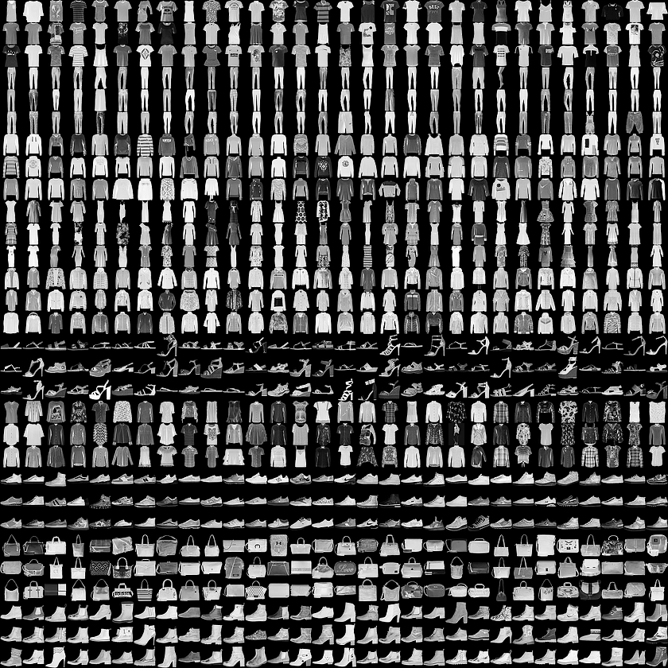
Example: MNIST dataset
MNIST (Modified National Institute of Standards and Technology database) is a large database of handwritten digits
60,000 training images and 10,000 testing images
Each image is a 28x28 grayscale image,
Labels: 10 classes (digits)
Example of dim. reduction on MNIST: Visualizing MNIST: An Exploration of Dimensionality Reduction - colah's blog
Fashion-MNIST is a database of Zalando’s article images
Drop-in replacement for MNIST
60,000 training images and 10,000 testing images
Each example is a 28x28 grayscale image, associated with a label from 10 classes
Labels: 10 classes (trousers, pullover, dress, coat, sandal…)
Figure from MNIST database - Wikipedia
[MNIST] LeCun et al., (1998), Proceedings of the IEEE, 86(11), 2278–2324 (1998)
[FashionMNIST] Xiao et al., arXiv:1708.07747 (2017); data available here: Fashion MNIST | Kaggle
Figure from zalandoresearch/fashion-mnist (github.com)

Slide 34
Tutorial: the first CNN (LeNet,1989)
Task: classify handwritten digits from 1 to 9 (MNIST dataset)
LeCun proposes the first convolutional neural network [1]
Arguably the first breakthrough in machine learning
Figure from Wikipedia
Figure from d2l.ai
[1] LeCun et al., (1998), Proceedings of the IEEE, 86(11), 2278–2324 (1998)

Slide 35

Generative vs Discriminative algorithms
Discriminative algorithms: given the input features $x^{\left(ⅈ\right)}$, how likely are $y^{\left(ⅈ\right)}$?
They make predictions based on input data $P\left(\left.y^{\left(ⅈ\right)}\right|x^{\left(ⅈ\right)}\right)$
Given the features $x^{\left(ⅈ\right)}$of a data instance $i$, they predict a label (classification) or value (regression)
Example 1: given all the words in an email (features), a discriminative algorithm could predict whether the message is spam or not spam (classification task)
Example II: given the chemical composition and atomic position (features), a discriminative algorithm could predict the superconducting temperature (regression task)
Generative algorithms: given $y^{\left(ⅈ\right)}$, how likely are the input features $x^{\left(ⅈ\right)}$?
Instead of predicting a label given certain features, they attempt to predict features given a certain label $P\left(\left.x^{\left(ⅈ\right)}\right|y^{\left(ⅈ\right)}\right)$
Example I: assuming this email is spam, how likely are these words?
Example II: given superconductive temperature $T_{C}=250 K$, how likely are these chemical compositions and atomic positions? Or better, which chemical compositions and atomic positions are likely to give raise to a $T_{C}=250 K$
Given such a model, one could sample synthetic data that resemble the distribution of the training data

Slide 36








Generative adversarial networks (GANs): intuition
Generative Adversarial Networks (GANs) are a way to make a generative model by having two neural networks compete with each other
$$x$$
(real data)
Discriminator $D$:
tries to identify real date from the fakes created by the generator
Generator $G$:
turns noise (random vector) $z$ into an imitation of the data to try to trick the discriminator
$$\hat{y}$$
$$D$$
$$G(z)$$
(fake data)
$$z$$
$$G$$
From Introduction to Deep Learning (MIT online course) http://introtodeeplearning.com/

Slide 37






GAN minimax formulation
Discriminator:
a binary classifier to distinguish if the input $x$ is real (from real data, $y=1$) or fake (from the generator, $y=$0)
Goal: $D\left(x\right)$ close to 1 (real data), $D\left(G(z\right))$ close to 0 (fake data)
train the discriminator to minimize the cross-entropy for classifying real vs fake:
$$\max_{D}{J_{D}}=\max_{D}\left\{𝔼_{x\sim Data}\left[\log{D\left(x\right)}\right]+𝔼_{z}\left[log⁡(1−{D\left(G(z\right)}))\right]\right\}$$
where $x\sim Data$denotes sampling from the training set
Generator:
Wants to fool the discriminator in classifying fake data in being real; $D\left(G(z\right)$ close to 1
$\min_{G}{J_{D}}=\min_{G}\left\{𝔼_{x\sim Data}\left[\log{D\left(x\right)}\right]+𝔼_{z\sim Noise}\left[log⁡(1−{D\left(G(z\right)}))\right]\right\}$
Discriminator and generator are playing a zero-sum game against each other:
$$\min_{G}{\max_{D}{J_{D}}}=\min_{G}{\max_{D}{𝔼_{x\sim Data}\left[\log{D\left(x\right)}\right]+𝔼_{z\sim Noise}\left[log⁡(1−{D\left(G(z\right)}))\right]}}$$
$$x$$
(real data)
$$D$$
$$G(z)$$
(fake data)
$$z$$
$$G$$
Zero-sum game: a situation in which each participant's gain or loss is exactly balanced by the losses or gains of the other participants.
Notes:
log prob of D predicting that real-world data is genuine
log prob of D predicting that G’s generated data is not genuine

Slide 38

GAN: generating realistic samples
Karras et al., NIPS 2020, ArXiv: 2006.06676

Slide 39
Tutorials: generative adversarial networks (GANs)
We will use the (great) tutorials from Dive into Deep Learning (http://d2l.ai/)
Generative Adversarial Networks (GANs): 17.1. Generative Adversarial Networks — Dive into Deep Learning 0.17.0 documentation (d2l.ai)
Link: http://d2l.ai/chapter_generative-adversarial-networks/gan.html
PyTorch implementation: gan.ipynb - Colaboratory (google.com)
Deep Convolutional Adversarial Networks 17.2. Deep Convolutional Generative Adversarial Networks — Dive into Deep Learning 0.17.0 documentation (d2l.ai)
Link: http://d2l.ai/chapter_generative-adversarial-networks/dcgan.html
PyTorch implementation: dcgan.ipynb - Colaboratory (google.com)

